Slide 1

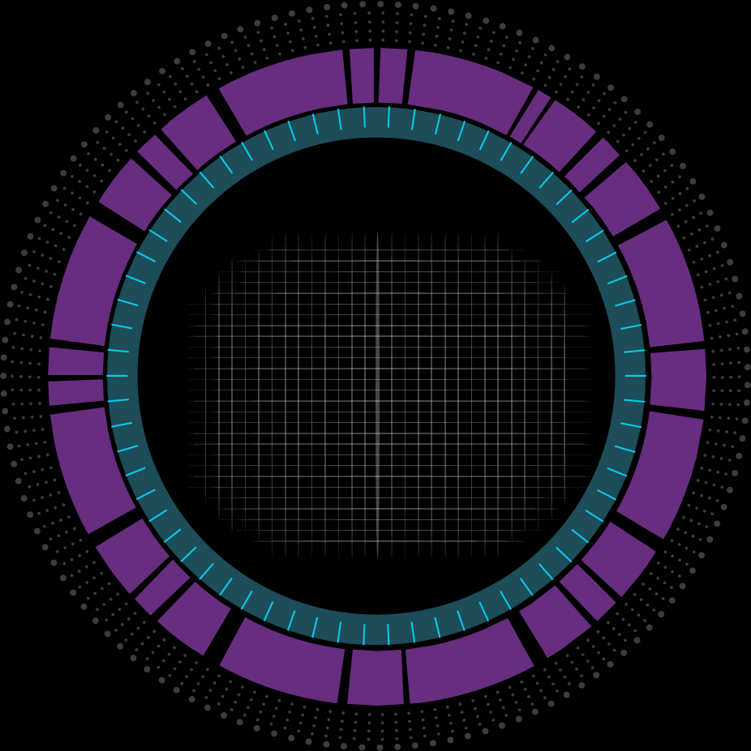
ONE-FOR-ALL GAMES
BY GAMINGVERSE INC.
MEMBERS:-
PIYUS PRITAM PADHY(19CSE075)
ANSHUMAN SARKAR(19CSE155)
DINESH KUNDO(19CSE166)
GUIDED BY:-
Dr DEBABRATA DANSANA

Slide 2
ACKNOWLEDGEMENT
WE DEEM IT A PLEASURE TO ACKNOWLEGDE OUR SENSE OF GRATITUDE TO OUR CLASS TEACHER “Dr Debabrata Dansana ” TO GUIDE ON PROJECT.
WE SHALL REMAIN GRATEFUL TO THE FACULTY MEMBERS,GIET UNIVERSITY FOR PROVIDING US A OPPORTUNITY TO DO THIS PROJECT BASED ON BASIC CONCEPTS THAT WE LEARNED AND TO IMPLEMENT THAT IN OUR PROJECT.
THIS PROJECT REALLY HELPED US A LOT TO IMPLEMENT OUR BASIC CONCEPTS THAT WE ALL NORMALLY LEARN THAT IS NORMAL CODING CONCEPTS .
DURING THIS COVID-19 PANDEMIC SITUATION WE REALLY ENJOYED DOING THIS PROJECT AND LEARNED A LOT OF NEW CONCEPTS.

Slide 3
IMPORTANCE OF PROJECT
ALL-FOR-ONE GAMES IS A COMBINATION OF MULTIPLE GAMES
IT INCLUDES HTML AND CSS WHICH MAKE THE OVERALL DESIGN AND GIVES OUR PROJECT A WEBSITE LOOK.
IT ALSO INCLUDES JAVASCRIPT WHICH WE USED TO DO THE CODING PART WHICH MAKES OUR PROJECT A GAME .
MAKING THIS PROJECT IS TO IMPLEMENT ALL THE BASIC CONCEPTS BASICALLY IF-ELSE STATEMENT WHICH IS VERY NECESSARILY USED IN OUR REGULAR CODING AND SOME JAVASCRIPT CONCEPTS.
THIS WHOLE PROJECT WORKING DEPEND MAINLY ON THE IF-ELSE STATEMENT ,JAVASCRIPT CONCEPTS AND GIVES US A CLEAR KNOWLEDGE OF IF-ELSE AND JAVASCRIPT.

Slide 4
HARDWARE REQUIREMENT
RAM: 8gb
PROCESSOR: INTEL I5 8TH GEN
VRAM: 4gb
STORAGE:1TB

Slide 5
SOFTWARE REQUIREMENT
OPERATING SYSTEM: WINDOWS 10
LANGUAGE USED: HTML CSS JAVASCRIPT
WEB BROWSER : GOOGLE CHROME

Slide 6
OBJECTIVES
THE APPLICATION WOULD PROVIDE A COMPLETE RELAXATION FOR ALL THE GAMERS OUT THERE AND NOT ONLY GAMERS BUT OUR GAME CAN ENTERTAIN
ALL AGE GROUPS.
THIS APPLICATION IS BASED ON NORMAL JAVASCRIPT CONCEPTS WHICH INCREASES OUR CODING SKILLS AND IT CONTAINS THREE GAMES IN IT WHICH GIVES OUR GAMES A NEW INTERESTING WAY OF PLAYING.
OUR ONE-FOR-ALL GAMES IS NEW KIND OF ONLINE GAMING PLATFORM WHICH REPRESENTS OUR TEAM CREATIVITY WE HAVE REMOVED THE OLD ETHICS OF BOARD GAMES AND REPRESENTED IT IN A RELAXING WAY USING NORMAL CODING SKILLS.

Slide 7
DESIGN DEVELOPMENT
HOVER: IT IS USED TO SELECT ELEMENTS WHEN YOU MOUSE(PLACE) OVER THEM.
BOX SHADOW: IT ADDS SHADOW EFFECT AROUND THE ELEMENTS FRAME.
TEXT SHADOW: IT ADDS SHADOW TOWARDS TEXT.
RGBA: THESE ARE THE COLOR VALUES WITH ALPHA CHANNEL WHICH SPECIFIES THE OPACITY OF A COLOR.
LI: IT IS A TAG ELEMENT WHICH IS USED TO REPRESENT A ITEM IN A LIST.
UL: IT REPRESENTS UN ORDERED LIST OF ITEMS RENDERED AS A BULLETED LIST.
LABEL: IT ACTS AS A CAPTION FOR A SPECIFIED ELEMENT.
NAV: IT REPRESENTS A SECTION OF A PAGE WHOSE PURPOSE IS TO PROVIDE NAVIGATION LINKS, INDESXES AND MANY USES.
DIV: IT FILES A DIVISION OR A SECTION IN HTML DOCUMENTS.
SPAN: IT IS AN INLINE CONTAINER FOTR PHRASING CONTENT WHICH DOES NOT INHERENTLY REPRESENT ANYTHING.
OFFSET:IT IS A METHOD THAT RETURNS THE SELECTED ELEMENTS TO THE DOCUMENT.
ONCLICK:IT GENERRALLY OCCURS WHEN THE USER CLICKS ON AN ELEMENT.
HIDDEN: DEFINES A HIDDEN BORDER.
SETTIMEOUT:IT IS A FUNCTION THAT EXECUTES A CODE FOR A CERTAIN TIME PERIOD .

Slide 8
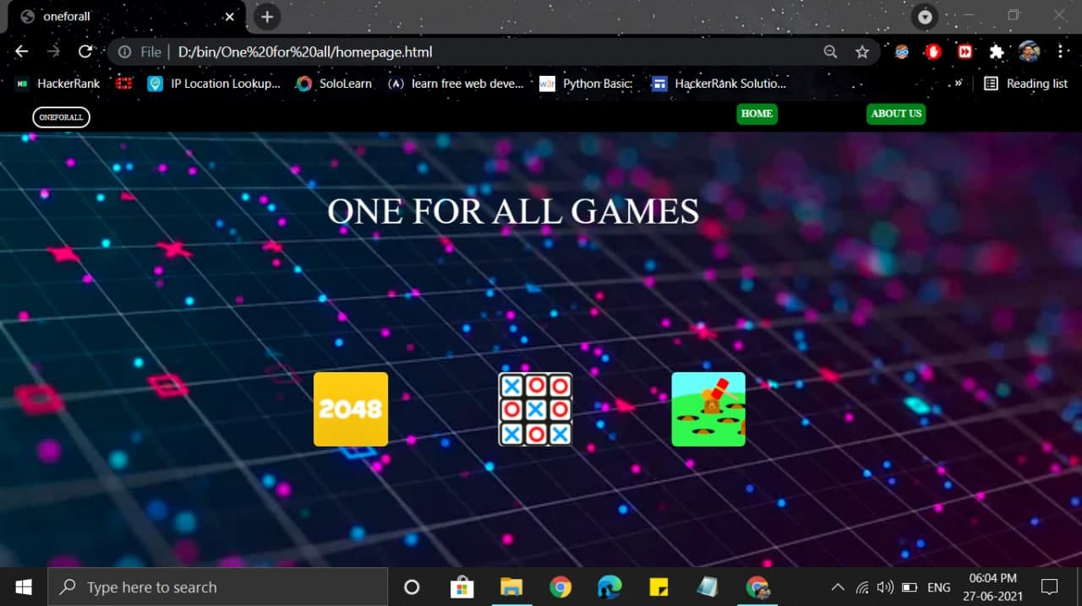
SNAPSHOT OF OUR PROJECT

Slide 9
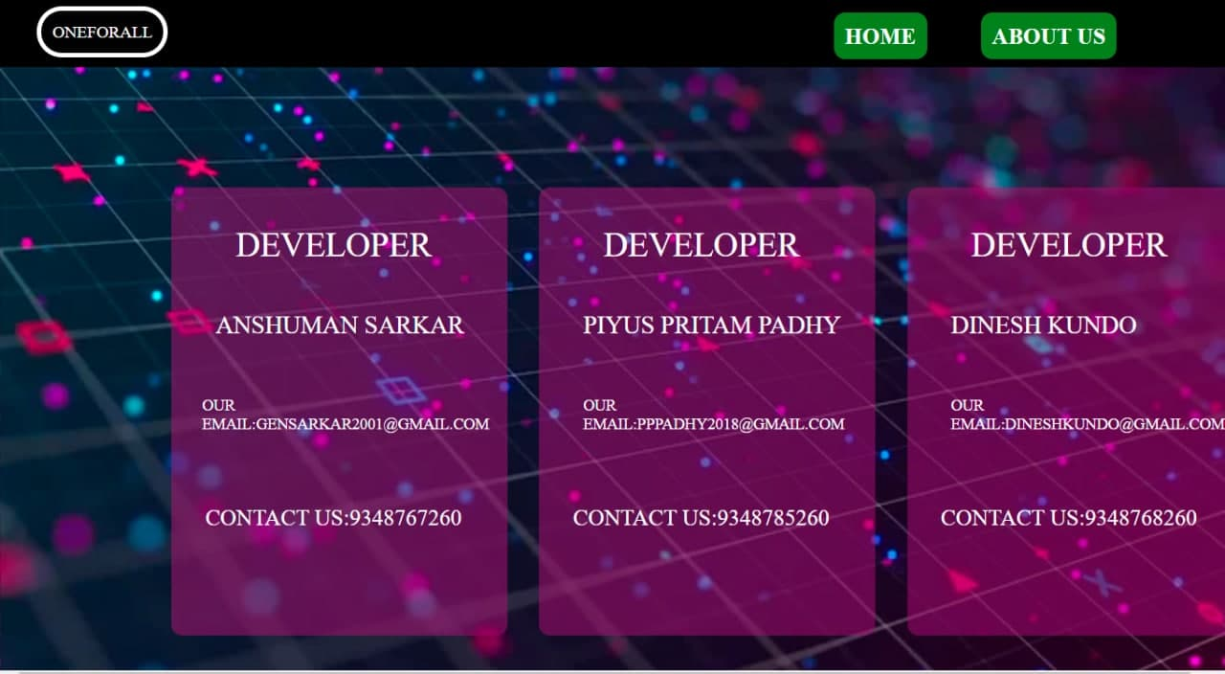

Slide 10
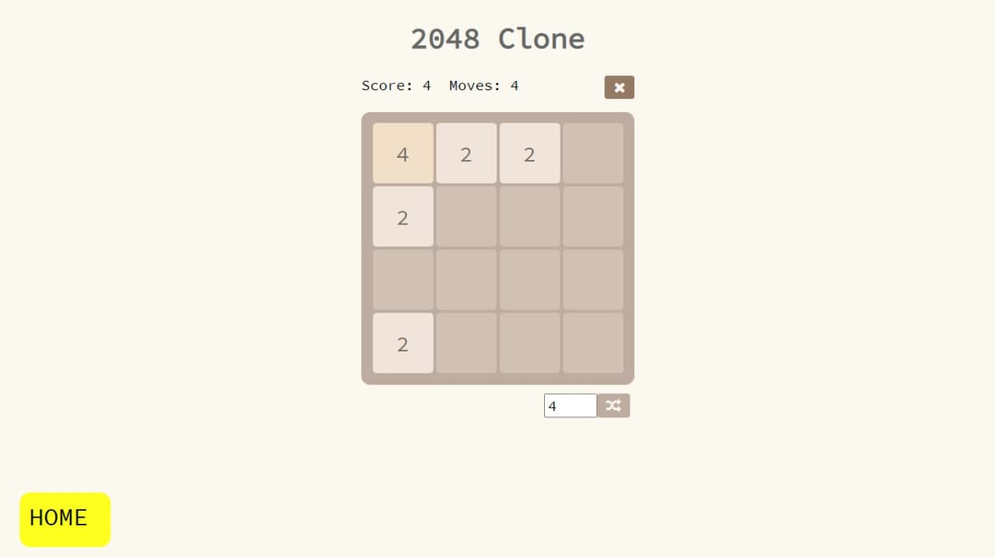

Slide 11
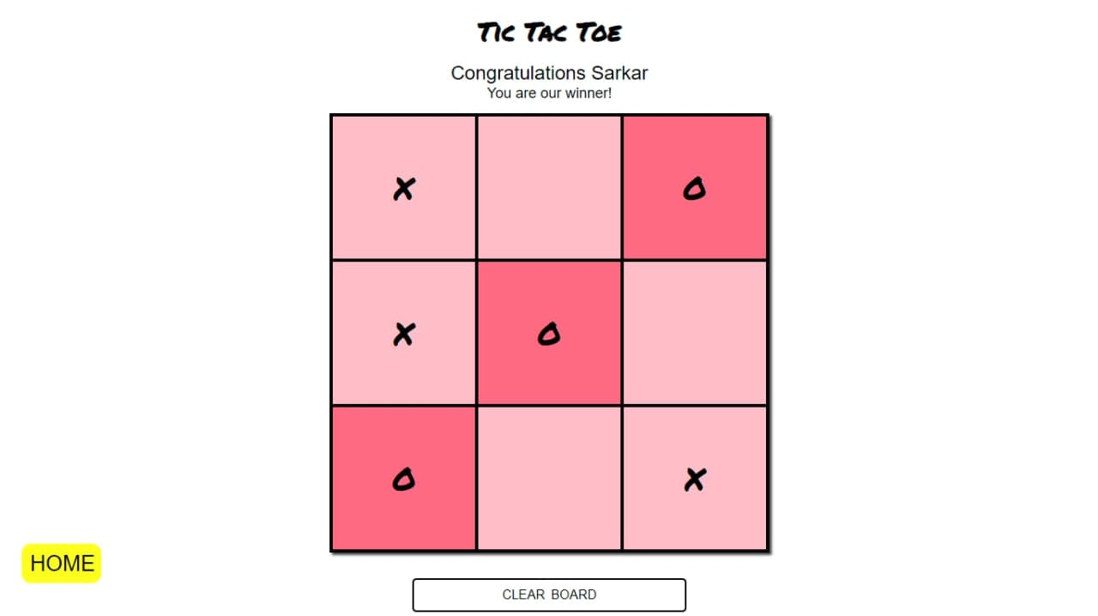

Slide 12
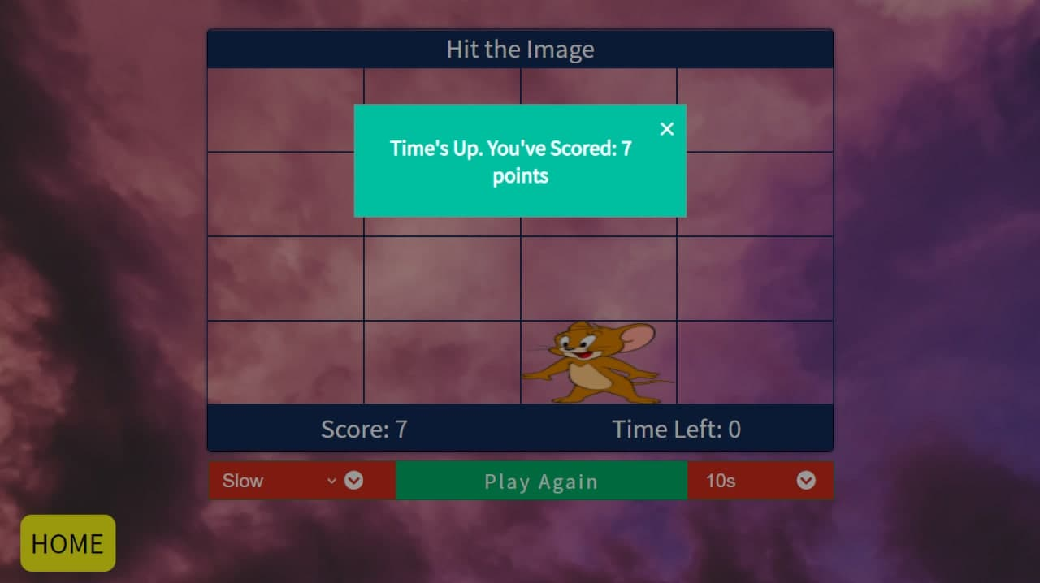

Slide 13
FUTURE SCOPE
BASICALLY OUR GAME THAT ISONE-FOR-ALL GAMES IS A VERY SIMPLE PROJECT .
BUT THE MAIN THING IS THAT IT COVERS ALL THE BASIC CONCEPTS OF CODING BECAUSE EVERY CODER LEARNS AND STARTS HIS/HER CODING JOURNEY FROM THESE ALL BASIC CONCEPTS THAT WE USED IN OUR PROJECT.
IN FUTURE THE CANDIDATE OR WHOSEVER CAN USE HIS/HER CREATIVITY AND CAN MAKE GAME BY ADDING SOME DIFFERENT TOUGH LEVELS.
OUR WHOLE CODING FUTURE IS ONLY DEPENDED ON THIS BASIC CONCEPTS BEACAUSE THERE IS A SAYING THAT IF FOUNDATION IS STRONG THEN BUIDING IS STRONG.

Slide 14
CONCLUSION
THE PROJECT WAS BASED ON ONE-OR-ALL GAMES IN JAVASCRIPT AND WE FINALLY ACHIEVE THE OBJECTIVE OF ENHANCING OUR CODING SKILLS AND BASCICALLY ANYONE CAN RELAX BY PLAYING OUR GAME AND IT BASICALLY REPRESENTS OUR CREATIVITY AND REPRESENTIN GAMES IN A DIFFERENT CREATIVE WAY.
ON COMPLETION OF ASSIGNED PROJECT,WE ARE NOW ABLE TO KNOW THE CONCEPTS OF JAVASCRIPT AND THE PROJECT DONE BY US DEPICTS THE UTILIZATION OF THOSE BASIC CONCEPTS WHEN IMPLEMENTATION PART IS CONCERNED RANGING FROM SYNTAX OF JAVASCRIPT , WRITING HTML TAGS AND DESIGNING THE PAGE AND VARIOUS JAVASCRIPT FUNCTION,CONNECTING PAGES, FUNCTIONS USED FOR RUNNING OF OUR GAME.
FROM THIS PROJECT WE REALLY IMPLEMENTED THE BASIC CONCEPTS THAT WE REALLY LEARN AS BEGINNER LEVEL AND IT CLEARED THE CONCEPT REAGRDING THR CODING AS WELL AS ON THE CONCEPTS OF JAVASCRIPT.
AND FINALLY AT LAST WE REALLY ENJOYED THE PROJECT THAT IS ONE-FOR-ALL GAMES

Slide 15
THANK YOU

